Slide 1
Welcome Journey
EVHC 2024
Luminare Health

Slide 2
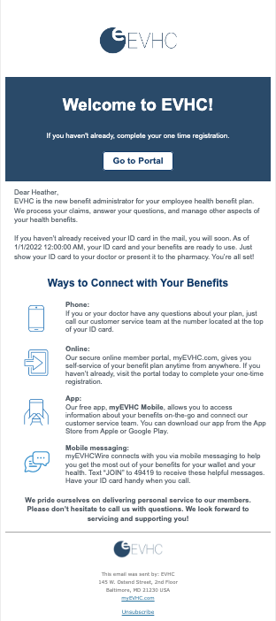
Email 1
Welcome

Slide 3
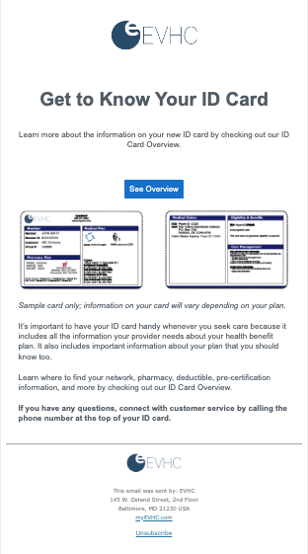
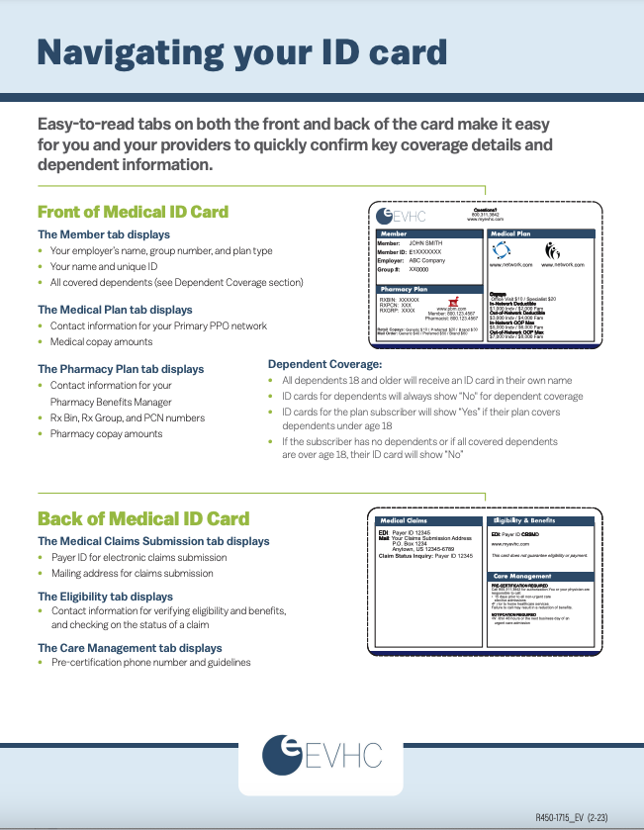
Email 2
ID card Tour

Slide 4
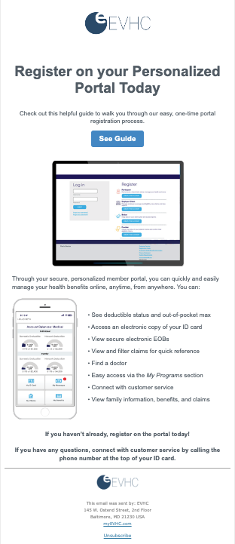
Email 3
Portal Registration

Slide 5
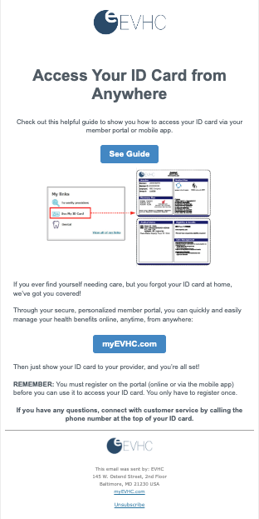
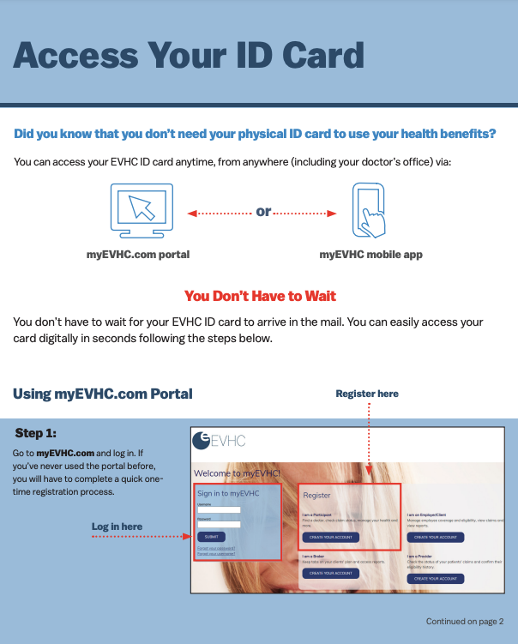
Email 4
Digital ID cards

Slide 6
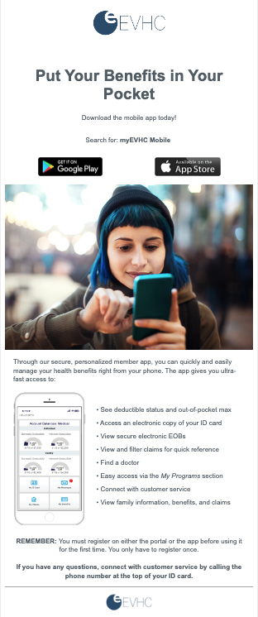
Email 5
Mobile app

Slide 7
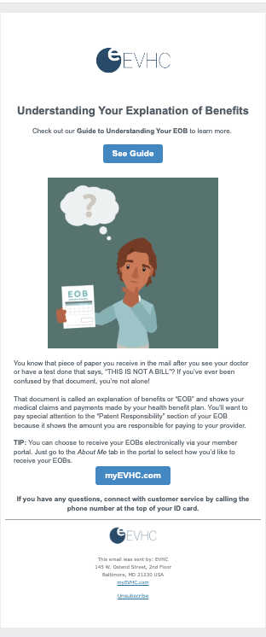
Email 6
Navigate your EOB

